Slide 1
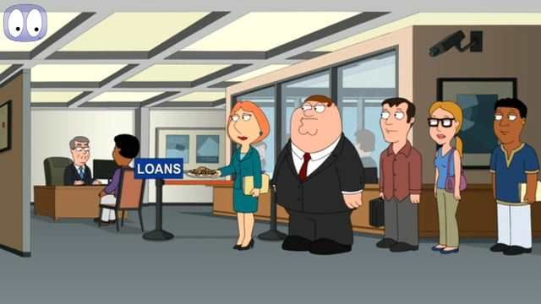
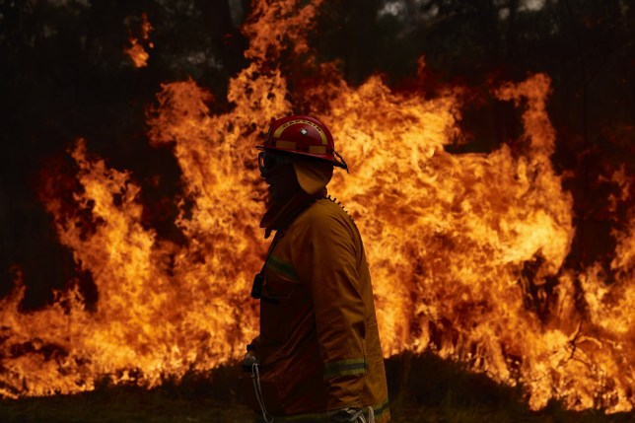
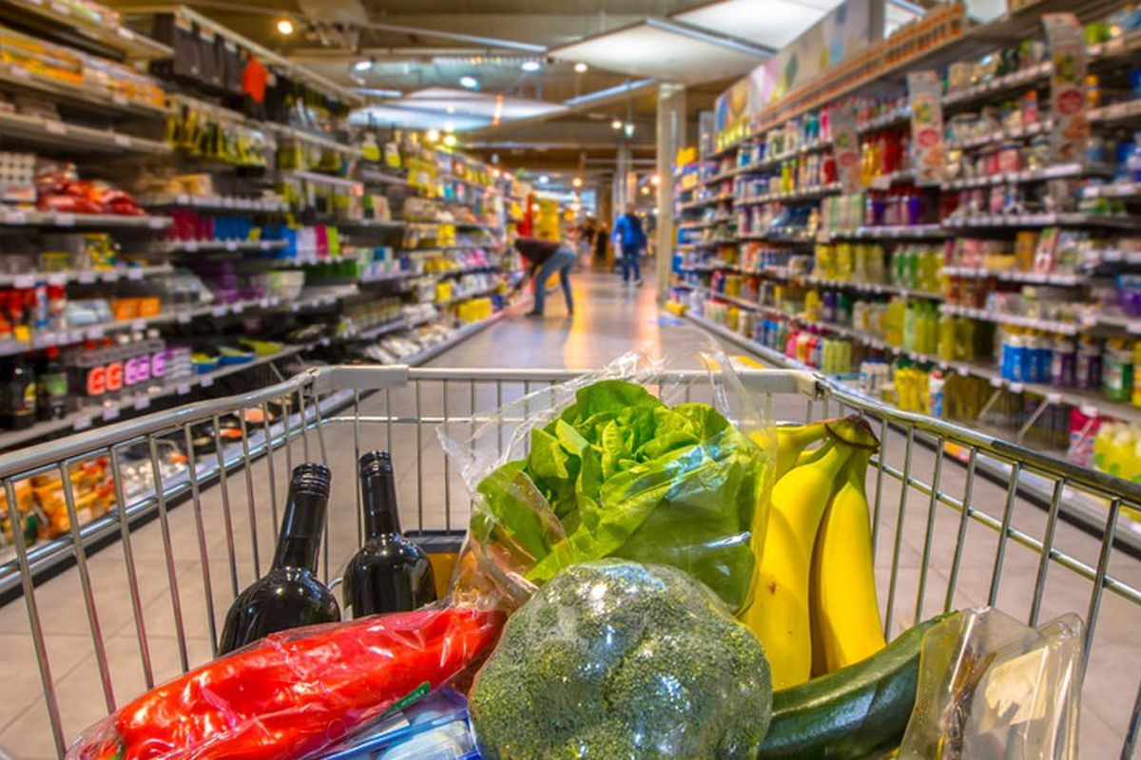
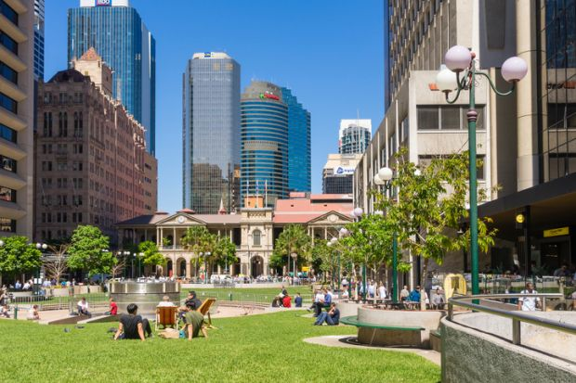
Conversation Class Australia
Christopher bAUMAN

Slide 2
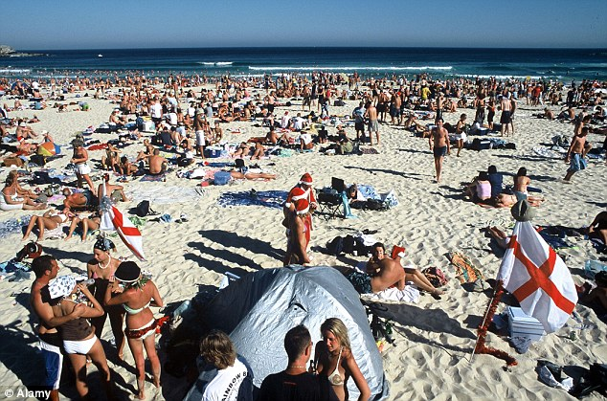
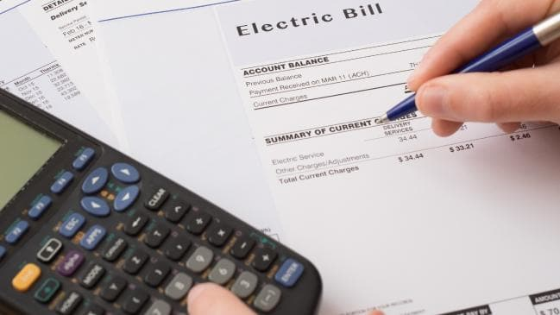
Education Infographic
Bank
Restaurant
Grocery shopping
personal transport
Fashion
Expenses
In the news
Teachers
Education
Skills
Chris Bauman

